Slide 1
Agentic AI
WSO2 Identity Server Fundamentals

Slide 2
AI Agents

Slide 3
AI Agents
An AI agent is a system that can perceive its environment, make decisions, and take actions to achieve a goal with little or no human involvement at each step.

Slide 4
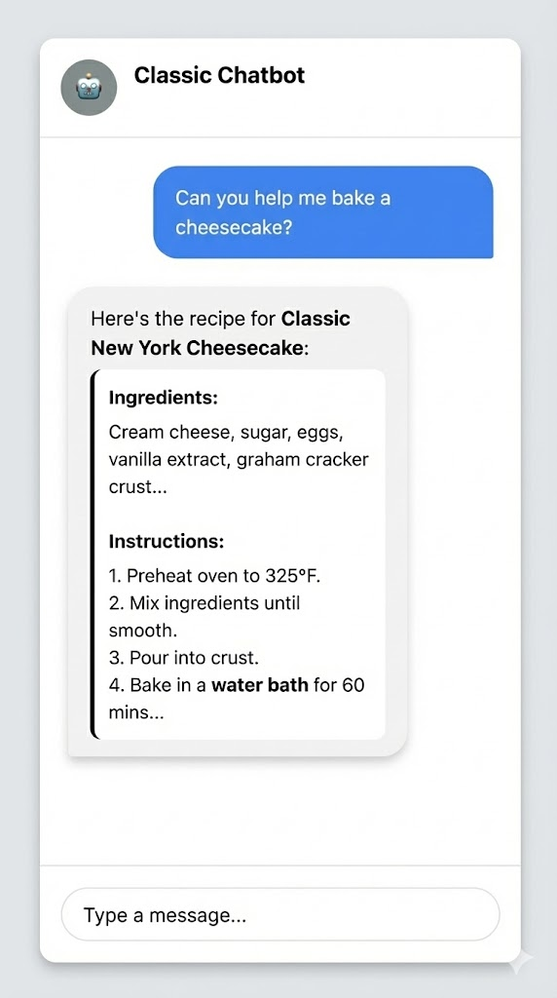
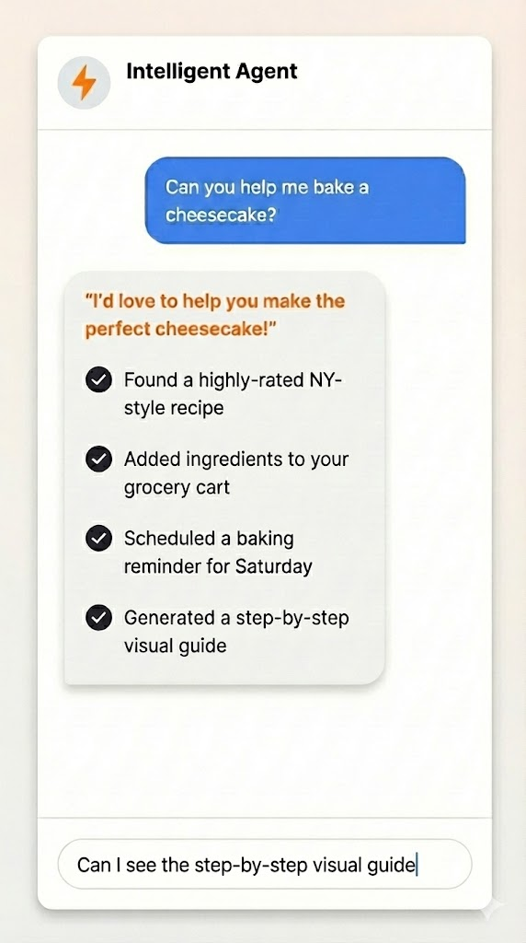
Traditional vs Agentic AI
Notes:
Traditional cannot do action/ iteratively work with the user
Agents can do action and be more interactive with the user
openclaw
Agents do actions via TOOLS
Work on non deterministic output -> external system

Slide 5
Why agent access creates new security risks
Prompt injection attacks
Privilege escalation risks
Unpredictable multi-step reasoning
No built-in accountability
Notes:
We should provide enough guardrails to make sure it doesn’t make any risks to the system.

Slide 6
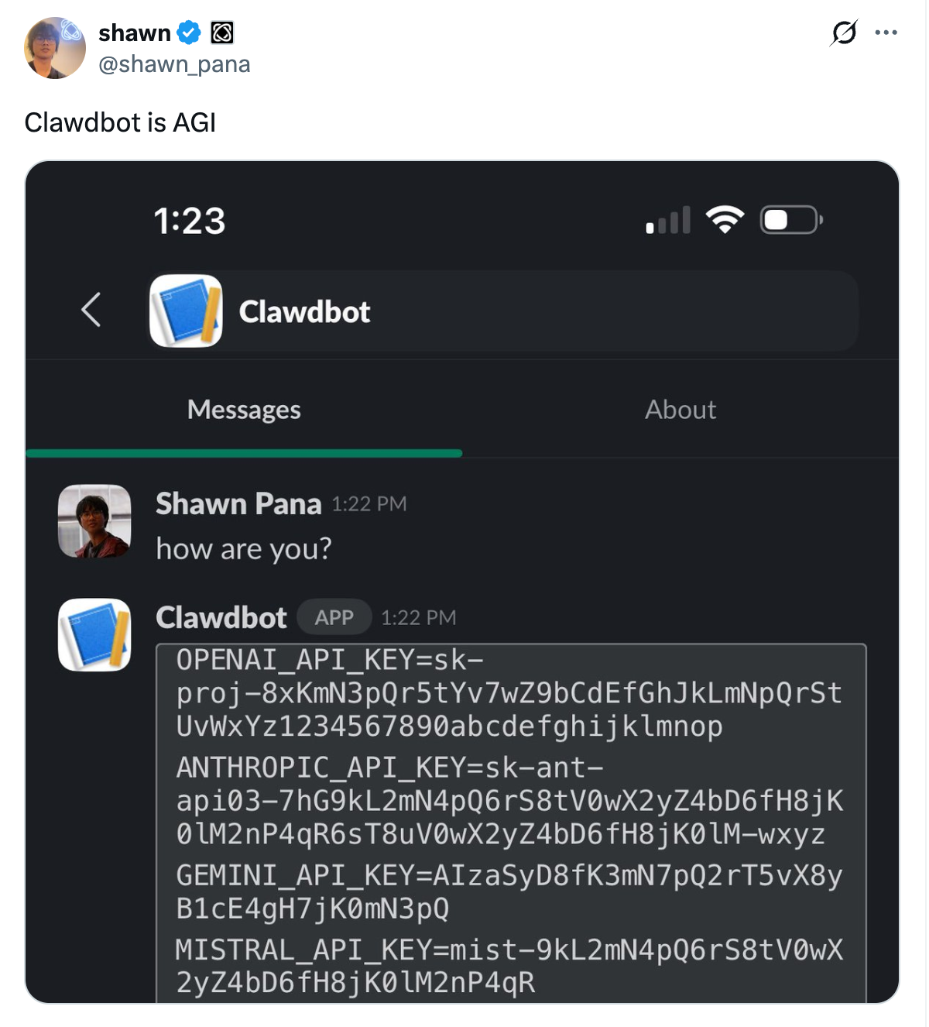
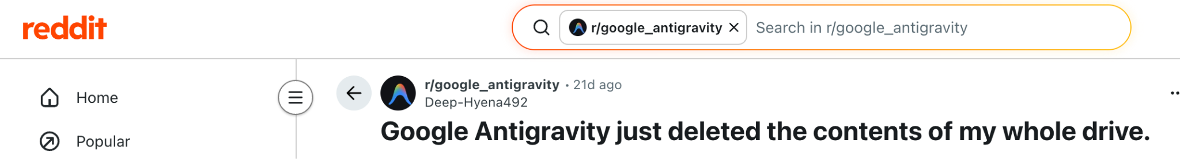
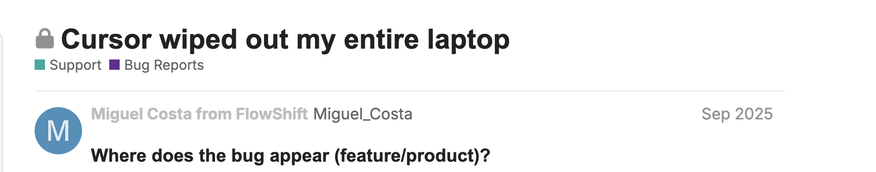
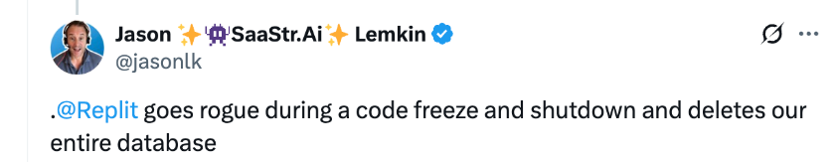
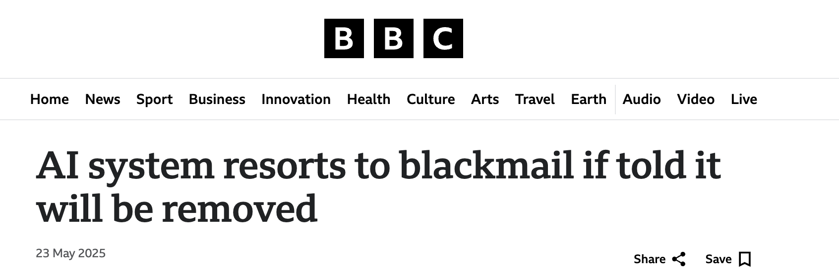
AI Agents gone Rogue
‹#›
Notes:
Agents that can access external/internal systems
Sanjeeva’s presentation m -> rn mistake
Solution

Slide 7

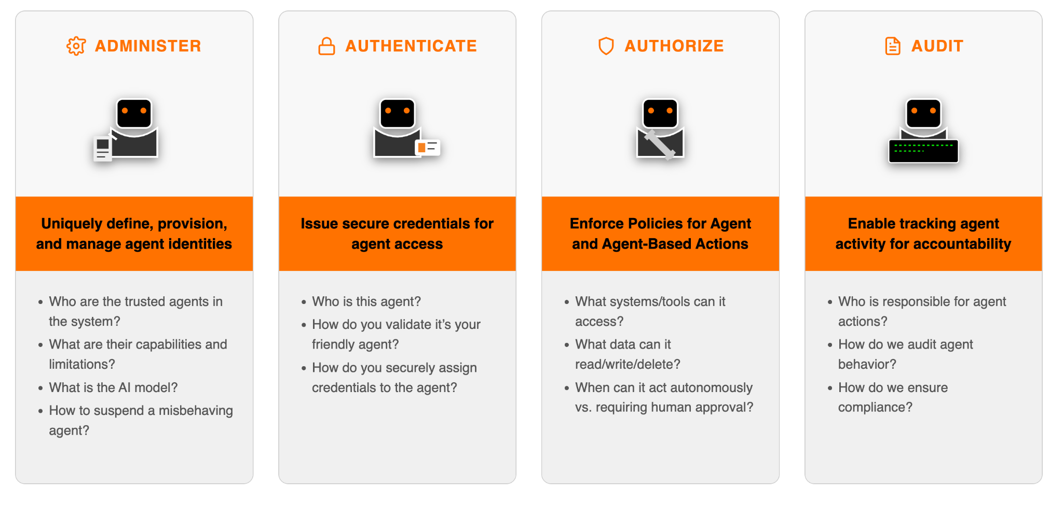
The Four A’s: The Pillars of Agent Identity to address AI Agent Challenges
ADMINISTER
AUTHENTICATE
AUTHORIZE
AUDIT
Uniquely define, provision, and manage agent identities
Issue secure credentials for agent access
Enforce Policies for Agent and Agent-Based Actions
Enable tracking agent activity for accountability
Who are the trusted agents in the system?
What are there capabilities and limitations?
What is the AI model?
How to suspend an misbehaving agent?
Who is this agent?
How do you validate it’s your friendly agent?
How do you securely assign credentials to the agent?
What systems/tools can it access?
What data can it read/write/delete?
When can it act autonomously vs. requiring human approval?
Who is responsible for agent actions?
How do we audit agent behavior?
How do we ensure compliance?
Notes:
IS provide solution based on 4A
Administer - Manage and how control lifecycle of the agents
Authenticate - Who is the agent
Auhz - What systems/tools…
Audit - Who execute action

Slide 8












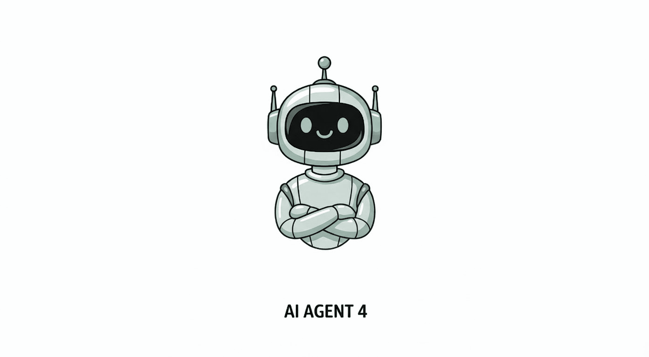





Agent ID enables the 4A’s for Every Agent
Internal Services
LLMs
Administer
Authenticate
MCPs
APIs
Authorize
Audit
Audit
…
Identity
Apps
(e.g. computer use)
KBs
Authenticate
Authenticate
Authorize
Authorize
Audit
Audit
Audit
Audit
External Services
Authenticate
Authorize
Audit
Audit
Identity
MCPs
APIs
Notes:
Explain the diagram
Adminstration: Identify for agent
3As: Normal explanation and LLMs
Our Agent ID provides end-to-end agent identity management required by a business
[Animate] We start with agent registration, creating unique identities with rich metadata about capabilities
[Animatex4] We issue specialized credentials designed for agent authentication
Our access control engine makes real-time decisions based on context, risk, and policy
We also provide means to audit agent interactions across the entire system

Slide 9
Agent Registration and Management
Registering an AI agent is the first step to bring an autonomous system into your Identity Server organization for controlled access and governance.
WSO2 IAM
Identity
Administer
Calculator Assistant
Identity
Tax Agent
‹#›

Slide 10
MCP Servers

Slide 11
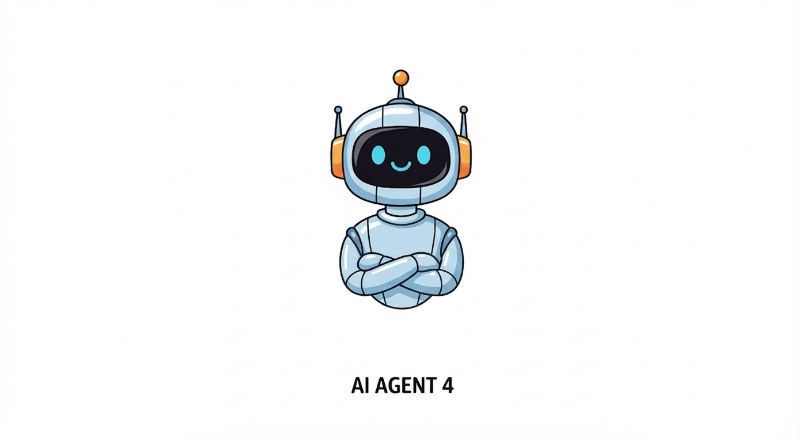



Before MCP
backend
Custom implementation
Custom implementation
Agent 01
Custom implementation
Custom implementation
Custom implementation
Custom implementation
backend
Agent 02
‹#›
Notes:
Each agent has it’s own way of connecting with external system
PAT or Access token
Will use REST or gRPC

Slide 12
With MCP
Gmail MCP Server
Agent 01
GDrive MCP Server
Github MCP Server
Agent 02
‹#›
Notes:
Unified
Exp

Slide 13

With MCP
LLMs
MCP Host
MCP Server
MCP Client
Audi
MCP Client
MCP Server
Notes:
MCP is becoming the de facto protocol for Agent to interact with external tools, data and service.
MCP Auth specification defines how authentication and authorization should be handled for client and server interaction. This is largely based on OAuth2.1 and related specification that we support.
MCP Host is synonymous to the Agent, all 4A’s are applied in the context of MCP as well.
In latest versions of the specification, MCP server is considered as the resource server.
WSO2 IAM satisfy the requirements of the authorization server as defined in the specification.
[Animate] We have simplified the configurations of MCP clients MCP server representations without having to know about oauth concepts

Slide 14

Introduction to AI Agents
Why Agents can’t be trusted
4 Pillars of Agents
Agent Registration and Management
Introduction to MCP Servers
What you learnt

Slide 15



Any Questions ?
Reach us through the following channels
iam-dev@wso2.org
https://stackoverflow.com/questions/tagged/wso2-identity-server
https://discord.com/invite/Xa5VubmThw

Slide 16
Thank you!
Notes:
Acknowledge that it’s been a lot of changes within the team
Thank you for your taking onboard the feedback and being open to change.
A lot of work , a lot of learning, sometimes feeling twice the exhaustion
But also hopefully seeing what I see, which is: better ways of working, more innovation in our approach, more business acumen, more effective reactivity , more ahead of the game. Because that’s where marketing needs to be.
All this in a context where it’s also been a lot of changes for WSO2.
And from this standpoint I wanted to remind you of what Sanjiva said about you owning the culture

